Slide 1
Leap Studio - A Virtual Interactive 3D Modeling Application based on WebGL
Nhat Quang Do
Hongming Cai
LiHong Jiang
School of Software & SEIEE
Shanghai Jiao Tong University
Shanghai, China
1

Slide 2
INTRODUCTION
3D modeling technology has proven its own importance with a lot of well-known 3D modeling software that can create 3D objects.
Now we can control 3D objects directly on web browsers by X3D or WebGL technology.
Interaction with such advanced feature through the traditional devices (keyboard, mouse…) will affect user experience.
2
Notes:
Nowadays it is possible for us to create 3D objects directly on web browsers. Web-based platform applications less hardware resource compared to the classic 3D software.
- X3D can be considered as the early form of Web-based 3D modeling. Limited features, weak graphic rendering ability and hardware usage make X3D a low-performance platform on web browsers.
- WebGL can be considered as the successor of X3D, provides a JavaScript API by combining OpenGL ES 2.0, HTML5 and JavaScript. WebGL has good hardware resources usage.
- Together with WebGL, there are already some stable libraries such as Three.js, LightGL.js.
- For creating a good bodily sensation-based interaction, motion sensing input devices such as Microsoft's Kinect and Nintendo's Wii remote have been invented but they still have some drawbacks.
-------------
- We introduce Leap Studio, an application designed basing on Virtual interaction technology and WebGL API.
- Using body movement sensors, which support multi-point movements and supported 3D modeling toolkit, Leap Motion device can complement the weaknesses of Kinect and Wii remote.
- Two main contributions :
we tested a new method of interaction by combining Leap motion device with WebGL technology to manipulate 3D models.
we found that the utilization of interaction between HTML and WebGL in 3D controlling can shorten browser's processing time and optimize system resource better.

Slide 3
RELATED WORK
Currently some body motion-sensing devices such as Kinect and Wii remote can help users of interaction with PC.
These devices have not entirely fulfilled the purpose of providing a 3D modeling-oriented.
The devices of cost are so expensive for normal user.
3
Notes:
In order to get one closer step to the bodily sensation-based interaction, some motion sensing input devices have been invented such as Microsoft’s Kinect and Nintendo’s Wii remote [6].
However, these devices still have not entirely fulfilled the purpose of providing a 3D modeling-oriented environment
While Kinect mainly serves for the gaming interaction aspect and the accuracy is still low when it comes to high details body motions, Wii remote must be activated by holding the remote along with pressing the buttons that will limit the use of hand- based operations which are important for 3D modeling [7]. Hence

Slide 4
RELATED WORK
3D objects manipulating through interactions, which is used for the purpose of creating visualization tools in education field. The system detects and tracks human hands from RGBD images that are captured using a sensor in Kinect. Experiment results in around 90% of system accuracy when recognizing hand status and gesture commands
_ee, J., Gu, H., Kim, H., Kim, J., Kim, H., & Kim, H. (2013, October). Interactive manipulation of 3D objects using Kinect for visualization tools in education. In Control, Automation and Systems (ICCAS), 2013 13th International Conference on (pp. 1220-1222). IEEE.
3D reconstruction which utilizes the Kinect sensor. Using the combination of color camera with depth camera feature in Kinect to perform 3D reconstruction task.
_Wan, Y., Wang, J., Hu, J., Song, T., Bai, Y., & Ji, Z. (2012, September). A Study in 3D-Reconstruction Using Kinect Sensor. In Wireless Communications, Networking and Mobile Computing (WiCOM), 2012 8th International Conference on (pp. 1-7). IEEE.
A mobile robot model with Kinect device that can function as a human motion tracking control system. Using Kinect’s skeleton tracking feature, the obtained 3D position information of human can be used to control the velocity and attitude of the robot directly
_Machida, E., Cao, M., Murao, T., & Hashimoto, H. (2012, August). Human motion tracking of mobile robot with Kinect 3D sensor. In SICE Annual Conference (SICE), 2012 Proceedings of (pp. 2207-2211). IEEE.
4

Slide 5
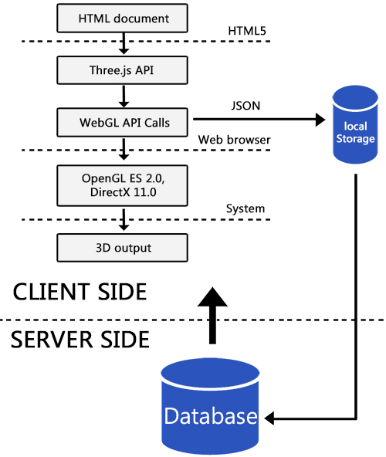
LEAP STUDIO OVERVIEW
Leap Motion Company has invented Leap Motion device that supports remote hand and finger motions as input.
Along with 3D creation tools and WebGL technology, Leap Studio utilizes Leap Motion device to create a virtual 3D working environment to users.
Since Leap Studio is a WebGL-based system, the process of creating 3D objects will be proceed on an API with HTML5 canvas and JavaScript control codes. WebGL has the ability to build 3D objects directly on web browsers, saving the trouble of installing additional plug-ins.
Figure 1. The Overall architecture of Leap Studio system
5
Notes:
Leap Motion Company has invented Leap Motion device that supports remote hand and finger motions as input.
Along with 3D creation tools and WebGL technology, Leap Studio utilizes Leap Motion device to create a virtual 3D working environment to users.
Since Leap Studio is a WebGL-based system, the process of creating 3D objects will be proceed on an API with HTML5 canvas and JavaScript control codes. WebGL has the ability to build 3D objects directly on web browsers, saving the trouble of installing additional plug-ins.
Leap Studio is mainly constructed based on Web3D.The system front-end is built from JavaScript. For the lower layers, we import the newest version of Three.js library which is possible to create GPU-accelerated 3D animations completely within the browser.

Slide 6
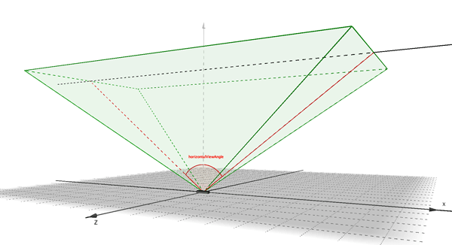
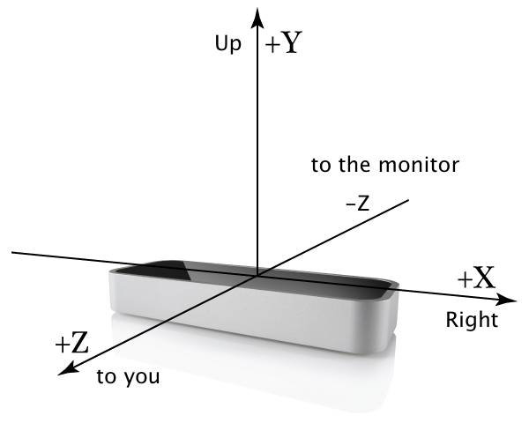
LEAP MOTION DEVICE
Leap Motion Company has invented Leap Motion device that supports remote hand and finger motions as input.
Along with 3D creation tools and WebGL technology, Leap Studio utilizes Leap Motion device to create a virtual 3D working environment to users.
Since Leap Studio is a WebGL-based system, the process of creating 3D objects will be proceed on an API with HTML5 canvas and JavaScript control codes. WebGL has the ability to build 3D objects directly on web browsers, saving the trouble of installing additional plug-ins.
Figure 2. The Leap Motion device
6
Notes:
Leap Motion is a compact device that can provide a virtual interactive system which we combine it with WebGL to enhance the experience of 3D modeling.
It contains two monochromatic cameras, which are used to capture the movement images of hand or fingers through three infrared LEDs. These LEDs produce a 3D pattern of dots of IR light and the reflected data generation can be completed at the speed of 300 frames per second.
After the motion images have been recorded, Leap Motion will calculate three angles of the triangle with its own algorithm, which results in the proper locations hand and fingers in the range of 1 meters hemispherical area from itself.
The data will be sent to the computer through USB cable and they will be analyzed by Leap Motion's built-in software.
The dimension for capturing the motions of hand and fingers is shaped like a quadrangular pyramid, where at the bottom of this pyramid is the location of the Leap Motion device.
With different sizes of the body parts and working environment, the motion-capture space can be maximized on minimized to meet the most demanding requirement of users.
Inside this dimension, based on the known parameters, the accuracy of recognizing the body motions-based operations can be precise up to 0.01 millimeter and the signals capture time delay falls from 5 to 10 milliseconds.

Slide 7
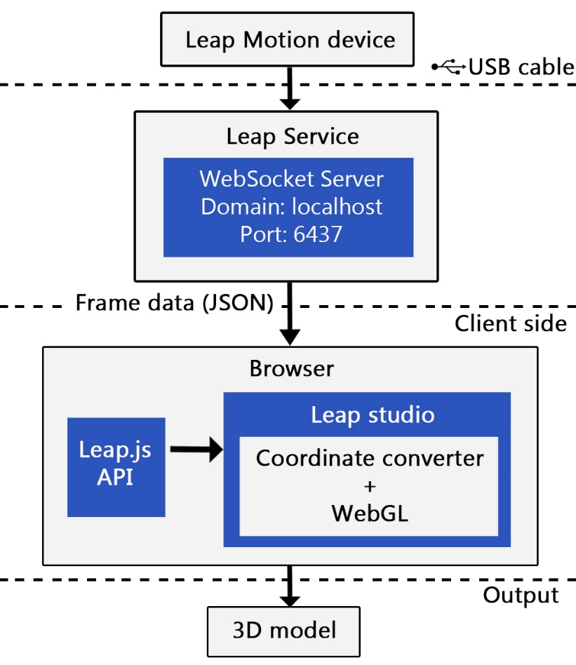
LEAP STUDIO'S INTERACTION
For solving the method of transfering the body motion data to the web browser to execute the interactive 3D modeling actions, we use the JavaScript SDK names Leap.js.
The implement of SDK from Leap Motion provider can be completed through adding Leap.js to the JavaScript source code of the client-side.
Developers can also install Leap Motion JavaScript library package and Node.js through Node Package Manager.
Figure 3. The overall architecture of Leap Motion device communication
7
Notes:
For solving the method of transfering the body motion data to the web browser to execute the interactive 3D modeling actions, we use the JavaScript SDK names Leap.js.
The implement of SDK from Leap Motion provider can be completed through adding Leap.js to the JavaScript source code of the client-side. Developers can also install Leap Motion JavaScript library package and Node.js through Node Package Manager.
The browser holds an important duty in receiving and analyzing the user's interaction data. There are a lot of interactive features in Leap.js API, which is supported by Leap Studio.
Not only the basic motions which include the movements of hands, fingers and tools, Leap Studio is also capable to receive some specific direction-supported gestures of hands and fingers such as sliding, pointing, zooming, etc. and the motions in 3D modeling jobs such as scale, rotation, and translation.

Slide 8
3D MANIPULATIONS
A "virtual mouse" or "virtual finger", is needed to control all the featured modules in Leap Studio application.
By connecting to a web socket server, Leap.js will transfer a frame to the web socket and the open page by every 10 milliseconds, where the frame is a block of JSON data which contains the position of hands and fingers.
The hand and finger movements will be monitored by Leap.js through the JavaScript function Leap.Loop().
The method of interaction between user's movements with Leap Studio's 3D Scene controller is through recognizing the pointing gesture of user's finger.
8
Notes:
A "virtual mouse" or "virtual finger", is needed to control all the featured modules in Leap Studio application.
By connecting to a web socket server, Leap.js will transfer a frame to the web socket and the open page by every 10 milliseconds, where the frame is a block of JSON data which contains the position of hands and fingers.
The hand and finger movements will be monitored by Leap.js through the JavaScript function Leap.Loop().
The method of interaction between user's movements with Leap Studio's 3D Scene controller is through recognizing the pointing gesture of user's finger.
Leap.js will extract the Fingertip position data from the frame data in the format of 3D coordinate (x,y,z). It will base on this coordinate to calculate the relative position of 3D vector through Three.js API:
Three.Vector3(x,y-200,y-camera.position.length)
When already got the relative coordinate of the 3D vector, bases on the location of the cameras, Leap.js will use conversion algorithm to convert the 3D vector's relative coordinate to absolute coordinate. This new absolute coordinate value will be assigned to the virtual pointer position.
pointer.position.addVectors(absolute position)
Assume that we have the Camera position of a 3D scene and (xc , yc , zc) is the 3D coordinate of the camera and (xr ,yr , zr) is the relative coordinate of the 3D vector.

Slide 9
3D MANIPULATIONS
Base on the algorithm to calculate the angles of a triangle, we have:
From the above result, we got the vector coordinate
Finally, we got the absolute coordinate of the 3D vector which is
pointer.position.addVectors(absolute position (dx,dy,dz))
9

Slide 10
3D MANIPULATIONS
Relative position of the vector can be extracted from this length through the following algorithm:
Relative position = Three.Vector3(tx, ty, tz)
The relative positive we just got will be converted to absolute position through the same method.
Camera.position = Vector3().addVectors
(absolute position, camera position)
Finally, the α angle of camera can be calculated once we have the camera position.
if α angle is larger than π /2, the 3D scenes or models will become invisible. We call this the “unlimited zooming” problem of Leap Studio. Restricting the camera angle can eliminate such bug.
10
Notes:
Being the same as virtual pointer control, camera control in Leap Motion is accomplished through verifying the number of open fingers of a fist.
Different camera angles of the 3D scenes will be changed along with the corresponding positions of userhand. Through analyzing the movements of user’s hand,
we have the translation (tx, ty, tz) of the 3D vector between two continuous frames, which can also be understood at vector’s length.

Slide 11
3D SCENES EDITOR
Leap Studio allows direct and real-time changing of the parameters of a 3D scene, thus enabling instant scene configuration without the need to edit codes and reloading the engine.
The default toolkit and user interface, which are provided by Leap Studio is 3D Scene editor, are programmed using JavaScript language and HTML5. With the advantage of being a virtual designing application, Leap Studio brings the 3D toolkit to users, which helps them easily build their own projects through the operations on 3D Scene editor
A dominant point of 3D Scene editor is that it is packed entirely inside the browser with a clean user interface. The menu is designed as the floating-style with various functions such as files I/O, editing, adding elements, etc. Users can freely rotate the viewing angle and configure their 3D model properties on the right panel.
11
Notes:
Leap Studio allows direct and real-time changing of the parameters of a 3D scene, thus enabling instant scene configuration without the need to edit codes and reloading the engine.
The default toolkit and user interface, which are provided by Leap Studio is 3D Scene editor, are programmed using JavaScript language and HTML5. With the advantage of being a virtual designing application, Leap Studio brings the 3D toolkit to users, which helps them easily build their own projects through the operations on 3D Scene editor. A dominant point of 3D Scene editor is that it is packed entirely inside the browser with a clean user interface. The menu is designed as the floating-style with various functions such as files I/O, editing, adding elements, etc. Users can freely rotate the viewing angle and configure their 3D model properties on the right panel. Since the working environment has been simplified to eliminate all the redundant elements, users can quickly get used to this system and begin their works immediately.

Slide 12
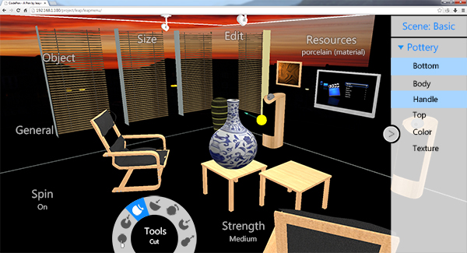
3D SCENES EDITOR
Figure 4. 3D Scenes editor platform
12
Notes:
Nowadays it is possible for us to create 3D objects directly on web browsers. Web-based platform applications less hardware resource compared to the classic 3D software.
- X3D can be considered as the early form of Web-based 3D modeling. Limited features, weak graphic rendering ability and hardware usage make X3D a low-performance platform on web browsers.
- WebGL can be considered as the successor of X3D, provides a JavaScript API by combining OpenGL ES 2.0, HTML5 and JavaScript. WebGL has good hardware resources usage.
- Together with WebGL, there are already some stable libraries such as Three.js, LightGL.js.
- For creating a good bodily sensation-based interaction, motion sensing input devices such as Microsoft's Kinect and Nintendo's Wii remote have been invented but they still have some drawbacks.
-------------
- We introduce Leap Studio, an application designed basing on Virtual interaction technology and WebGL API.
- Using body movement sensors, which support multi-point movements and supported 3D modeling toolkit, Leap Motion device can complement the weaknesses of Kinect and Wii remote.
- Two main contributions :
we tested a new method of interaction by combining Leap motion device with WebGL technology to manipulate 3D models.
we found that the utilization of interaction between HTML and WebGL in 3D controlling can shorten browser's processing time and optimize system resource better.

Slide 13
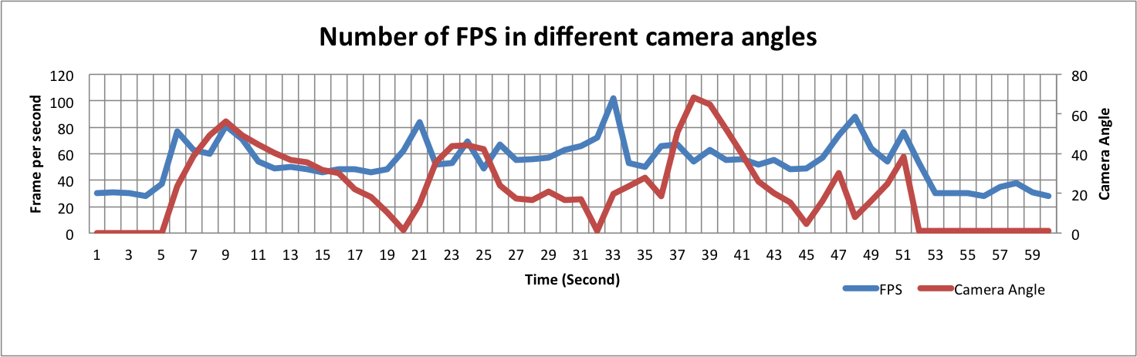
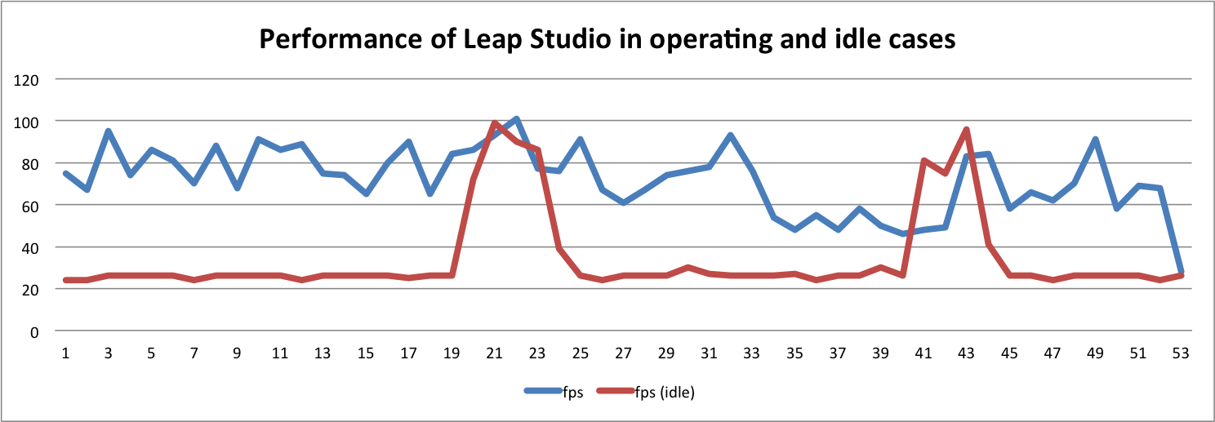
EXPERIMENT RESULTS
Figure 5. Relation between FPS and camera angles in Leap Studio
Figure 6. Performance of Leap Studio in operative case and idle case
13
Notes:
The performance of Leap Studio is measured by the amount of frames generated in a second, which is noted as frames per second (fps). The whole testing process is a continuous loop which interval between each time in the loop is 5 to 10 milliseconds at least. Each time, we render a frame and get the values including fps and the average duration to create a frame.
Once the test stops, the max and min fps of whole running process is calculated. We ran Leap Studio in around one minute and recorded down all the fps values in two cases: operative case and idle case. As the result shown in figure 5, when Leap Motion is being manipulated, the application generates high amount of fps but the values are not stable
------------------------------
Test of relation between fps and camera angles is also performed in in two cases: idle and operative. When user does not make any gestures to manipulate 3D objects, which means the camera angle does not change, the fps values remain stable as 30. There are two cases when number of fps suddenly increases to high values after only few second.
The first case is the switch from idle case to operative case, when user begins to manipulate objects and the second case is when camera angle increases from the minimum to a larger angle.
Beside from those, no matter how camera angle changes, the fps values remain at around 50 to 60 consistently most of the time. When fps values are increased suddenly, it will automatically return to the stable value afterward. The experiment result of fps values in varied camera angles is shown in figure 8.

Slide 14
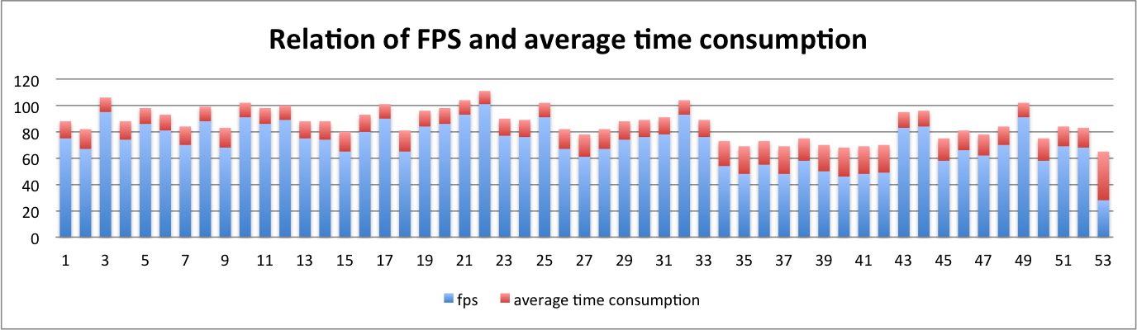
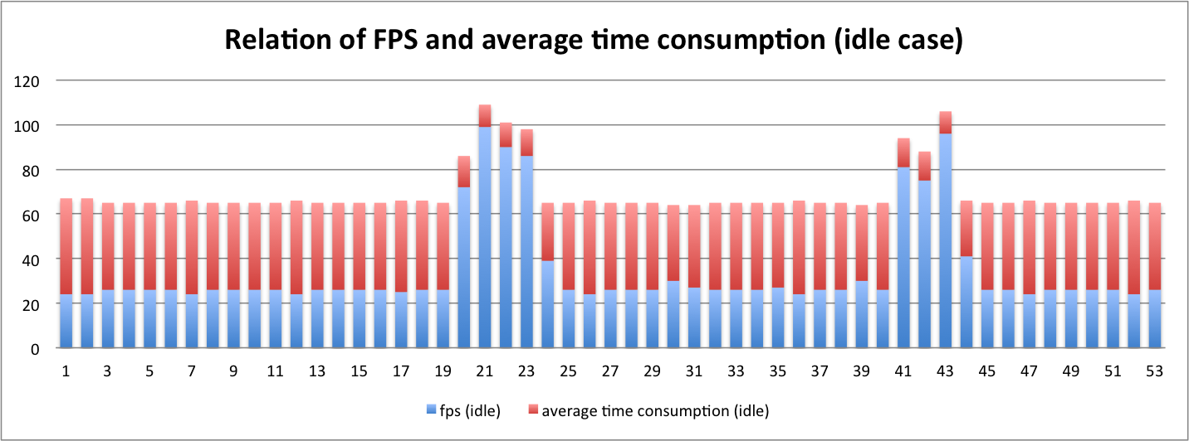
EXPERIMENT RESULTS
Figure 7. Performance of Leap Studio in operative case and idle case
Figure 8. Average time consumption and generated FPS of Leap Studio in idle case
14
Notes:
In contrast, the idle case where Leap Motion is left running without any manipulations, nearly 25 fps is generated most of the time during the process except two short periods when the fps values become high. Fps values in this case are lower but more stable.
The results in figure7 and figure 8 demonstrate the relations between fps and average time consumption in operative and idle cases respectively. Both tell that when the time used to create a frame is longer, the number of generated fps will be fewer and vice versa.

Slide 15
CONCLUSION
In this paper, we introduced Leap Studio, a Leap Motion-based 3D modeling interactive application with WebGL technology.
Being able to get into function directly on the web browsers without using any plug-ins, WebGL is considered high-efficiency and easier to use when compared to other 3D graphic modeling APIs.
The combination of WebGL 3D objects and HTML elements prove that manipulating HTML elements through a virtual pointer is possible. Gesture-based 3D interaction eases the progress of 3D modeling.
15
Notes:
In this paper, we introduced Leap Studio, a Leap Motion-based 3D modeling interactive application with Web technology. Being able to get into function directly on the web browsers without using any plug-ins, WebGL is considered high-efficiency and easier to use when compared to other 3D graphic modeling APIs.
The combination of WebGL 3D objects and HTML elements prove that manipulating HTML elements through a virtual pointer is possible. Gesture-based 3D interaction eases the progress of 3D modeling. Such technology makes it an adequate method to manipulate 3D objects or scenes with simple operations.

Slide 16
FUTURE WORK
in future works, it will support 3D graphic projection devices such as projectors along with emulation glasses.Furthermore, the system will be improved to support two-hand operations from the current single-hand control.
Combining Leap Studio application with 3D printers makes it possible for designers/artists or even end-users to bring their creative products into real life.
Other than that, gaming industry can develop new types of interactive game such as shooting games, fighting games, etc. once these features are brought into use.
Leap Studio can also be useful in medical science, especially in surgical operations and other fields such as education.
16
Notes:
Leap Studio is still in the developing stage. Currently simple 3D objects modeling can be done through the Leap Motion device which produces on-screen result only, however, in future works, it will support 3D graphic projection devices such as projectors along with emulation glasses.
Furthermore, the system will be improved to support two-hand operations from the current single-hand control [18]. Combining Leap Studio application with 3D printers makes it possible for designers/artists or even end-users to bring their creative products into real life.
Other than that, gaming industry can develop new types of interactive game such as shooting games, fighting games, etc. once these features are brought into use. Leap Studio can also be useful in medical science, especially in surgical operations and other fields such as education.

Slide 17
End
THANK YOU
Q&A

